Slide 1



ACTIVATE
Milestones
WADHWANI FOUNDATION | Entrepreneur
01

Slide 2


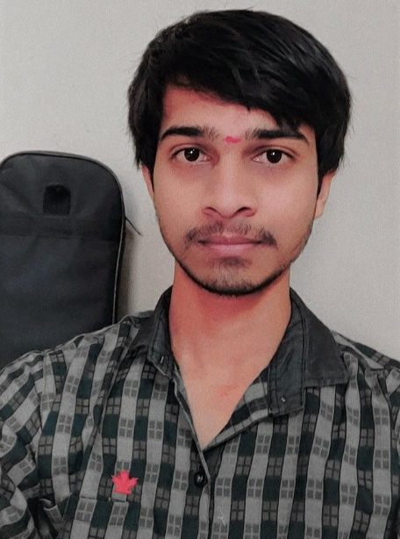
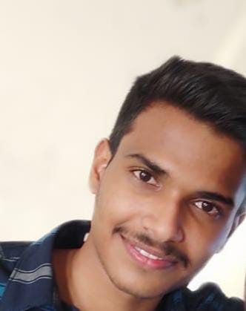
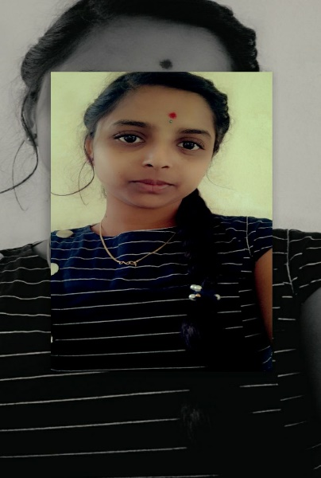
INTRODUCTION AND TEAM COMPOSITION
WADHWANI FOUNDATION | Entrepreneur
Business Name: ! DO KNOW
PV ID:
Team members names | Strengths and abilities | Role/Position
Tarun Kotagiri | Growth mindset, Confident. | CEO
G. Vivek | Strategic planning, Innovative thinking, | COO/CTO
P. Sushma | Hard working, Quick learning | CFO/CMO
What makes us a good team to solve the problem we chose?
We share a common goal of improving the education style and making an impact on the STUDENT life. All of us work hard towards our aligned goal, we offer each other support, we communicate well with each other, We have fun working together.
Each of our team mates a variety of skill sets. Tarun is a 3d designer, Ethical hacker, great programmer with a lot of technical experience. Vivek is greatly dedicated to his work . Come rain or shine ,Vivek finishes any task . Sushma is good with her communicational skills. She has good connectivity with people. Hence, our team is good to solve the problem we chose.
TARUN VIVEK SUSHMA
02
Creating Jobs. Changing Lives.

Slide 3


PROBLEM STATEMENT CANVAS
WADHWANI FOUNDATION | Entrepreneur
PROBLEM STATEMENT: Difficulty in visualization of Academic concepts.
Though lot of students attain classes regularly, many of them find difficulty in understanding the concepts. Many factors can effect the conceptual understanding of a student. Being not able to visualize the concepts perfectly is one such main factor. It causes bad impact on student’s Conceptual understanding. Students lose interest in learning too.
Good visualization improves understanding, gives clarity, enhances attention for every student.
Most of the students use online platforms like YouTube,BYJUS, Khan Academy and other academic platforms to understand the concepts. Most of the content are either written or
2-dimensional.This is one main drawback of the online platforms.
02
Creating Jobs. Changing Lives.

Slide 4


CUSTOMER
WADHWANI FOUNDATION | Entrepreneur
Place your
Results
What is your Market type? | B2C
What is your TAM - Total Addressable Market? | 601 million students
What is your SAM – Serviceable Addressable Market? | 949000 students
What is your SOM – Serviceable Obtainable Market? | 120000 students
What is your Niche? | B-tech students of Hyderabad.
02
Creating Jobs. Changing Lives.

Slide 5
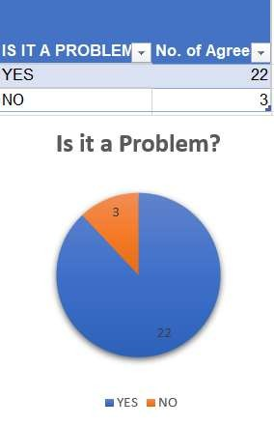
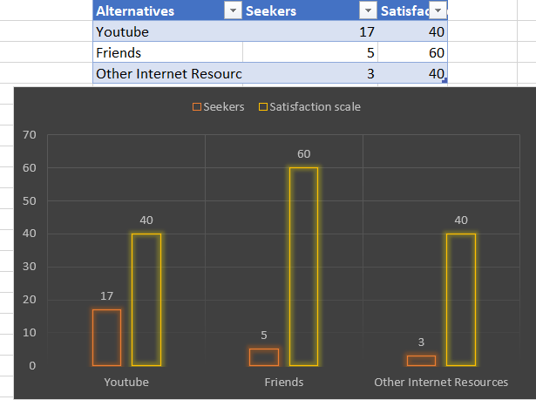


RESULTS OF THE SURVEY:
WADHWANI FOUNDATION | Entrepreneur
https://docs.google.com/spreadsheets/d/1djKbqE3K7Ztrs5pyBlZ5pT7ORl8xAgyH7xftgP
Results
How many customers did you interview? (At least 25 for B2C and 2 for B2B) B2C - 25
How many of them agree this is a problem that needs to be solved? 22
How many of them said they can already solve this problem and don't need a new solution? 3

Slide 6
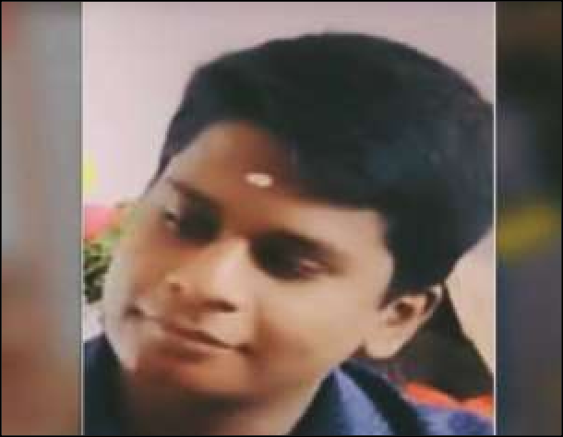

CUSTOMER PERSONA (PRESENT CUSTOMER PERSONA FOR ALL CUSTOMER SEGMENTS)
WADHWANI FOUNDATION | Entrepreneur
Goals:
*To complete his graduation without any backlogs.
*To get placed in an MNC.
Frustrations:
*Unable to understand all the academic concepts
*Unable to clear all the subjects in the semester exams
Goals
• ?
• ?
• ?
• ? Frustrations
• ?
• ?
• ?
“I’m a determined and enthusiastic person”
Motivations
His family and friends are constant motivation to Thanuj
Age (in years):20 Gender: Male
Profession: Student
Personality
Bio
Thanuj is a young and enthusiastic student studying computer science in KGR. He loves to watch movies and play cricket. He aims to be placed in a MNC and have good salary to lead his family. He attends all the classes regularly yet find it difficult to understand the topics from his syllabus due to lack of concept visualization. He uses YouTube to understand the concepts but still not satisfied with it.
Joyful, hard-working and honest.
Creating Jobs. Changing
Lives.

Slide 7
Thank You!

